Slide 1

Gun Violence in Major Cities
Name:
Tutor:
Course:
Date:
Notes:
Gun violence is an important topic within the current society. gun violence has been on the rise within the major US cities.

Slide 2

Abstract
Gun violence in the United States has been rampant within the big cities.
Gun violence is an urgent and complex issue.
There is no single profile that can reliably predict the person who will use a gun in a violent act.
Instead, gun violence has been linked to a confluence of community, peer, school, family, individual, and sociocultural risk factor that interact over time during childhood and adolescence.
This study will has been prompted by the increase in gun violence.
It is geared towards studying gun violence within the major cities.
Notes:
Gun violence has been on the increase within the major cities in the United States. This kind of trend has been linked to a confluence of community, perr, school, family, individual, and sociocultural risk factors interacting since childhood all through to adolescence stage.

Slide 3
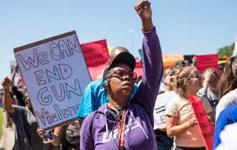
Introduction
Gun violence has been on the rise within the United States major cities.
Many major United States cities, including Chicago, Philadelphia and New York, have witnessed an up surge in the number of shootings as well as subsequent fatalities.
Between January and July 2020, there has been a total of 777 recorded shootings in New York City.
This is more than the number of recorded shootings in the calendar year of 2019.
Notes:
Gun violence has been debated within the US for a long time. Despite of the calls to stop shootings, most of the major cities in the US such as Chicago and New York has witnessed an increase in the recorded shootings (Tommy, 2020).

Slide 4

Reasons for the Increase of Gun Violence
Social inequality.
Income inequality
Poverty
Lack of opportunity and perceptions of hopelessness.
Easy access to firearms by high-risk people
Nationwide social unrest.
The coronavirus pandemic.
Typical summertime spike in shootings.
Notes:
There are various reasons for the increasing incidences of gun violence in US major cities. Some of these reasons are social, inequality, income inequality and poverty as well as others (Gabor, 2016).

Slide 5

Prediction
The prediction of an individual’s propensity for violence is a complex and challenging task for mental health professionals.
Mental health professionals are expected to take action when they predict that their patient might get involved in gun violence.
There is no consistent psychological profile or set of warnings that can be relied on to pick on the people who will get involved in gun violence.
Individuals who might cause violence are usually troubled, depressed and hopeless over their circumstances in life.
Notes:
There is no consistent way through which gun violence can be predicted (Webster & Bloomberg, 2013). However, people who might likely be involved in gun violence are usually troubled, depressed and unhappy over their circumstances in life.

Slide 6
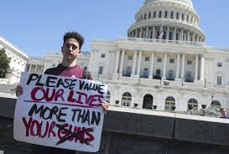
Prevention of Gun Violence
Put in place sensible gun laws.
Create a gun safety culture within the society.
The government and the society to support gun violence research.
Support society planning and implementation of comprehensive community safety plans
Mental health and wellbeing
Explore the connections between anger and gun violence
Notes:
There are different ways to prevent gun violence within the major cities in the US. One of the ways is that of ensuring that there are sensible gun laws in place and creating gun safety culture, among others (Kerr, 2018).

Slide 7

Recommendations
Reduction of easy access to dangerous weapons.
Creation of a gun safety culture
Public health to recognize gun violence as a critical and preventable public health issue.
Support community planning as well as implementation of comprehensive community safety plans.
Notes:
Gun safety should be given first priority as it has caused so many lives to be lost. The community should come up with plans that will ensure there is a reduction in gun violence incidences (Kerr, 2018). Some of this ways are restricting access to dangerous weaponry, and putting in place a gun safety culture among others.

Slide 8
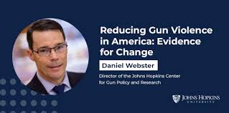
References
Kerr, S. E. M. (2018). Gun violence prevention?: The politics behind policy responses to school shootings in the United States.
Webster, D. W., & Bloomberg, M. R. (2013). Reducing gun violence in America: Informing policy with evidence and analysis. Baltimore, MD: Johns Hopkins University Press.
Gabor, T. (2016). Confronting gun violence in America.
Tommy, B. (2020). Shootings and Gun Deaths Continue to Rise at Alarming Rate in Large U.S. Cities. Forbes, https://www.forbes.com/sites/tommybeer/2020/08/02/shootings-and-gun-deaths-continue-to-rise-at-alarming-rate-in-large-us-cities/?sh=41dfaac06f0f.

